Slide 1
Opening an Indian Restaurant in Vancouver
Abhijith Ravishankar

Slide 2
Business Problem
Vancouver, a bustling west coast seaport in British Columbia, is among Canada’s densest, most ethnically diverse cities known for its art and scenery. With a population of over 2.5 million, there are more than 200 ethnic groups in the country, making up more than 16 per cent of the total population.
Seeing the popularity of Indian food in Vancouver, the objective of the project is to use Foursquare API and clustering to best determine a location in Vancouver suitable to open an Indian restaurant. This will help business owners in deciding a convenient and apt location to open up a restaurant.

Slide 3
Data acquisition and cleaning
This project will use Vancouver neighborhood data, Geolocation of Vancouver and Foursquare API to figure out which neighborhood will be an ideal location to open an Indian restaurant.
Data scraping and cleaning up the British Columbia Province Neighborhood Data from Wikipedia - https://en.wikipedia.org/wiki/List_of_postal_codes_of_Canada:_V
The postal codes shown in this site are the ones for British Columbia, these will be narrowed down to only the ones that include ‘Vancouver’ in their Borough
Geolocation of Vancouver - Will be determined via the Geocoder Package https://www.serviceobjects.com/blog/free-zip-code-and-postal-code-database-with-geocoordinates/
With the help of Postal Code Database, the above file in CSV will be then transformed into a data frame for further analysis
Foursquare API – to show the location of various Indian restaurants and the ones lacking of such restaurants https://developer.foursquare.com/
Using this and my API credentials to explore the various venues in and around Vancouver

Slide 4
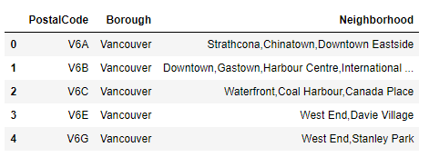
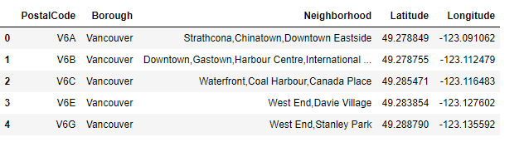
Methodology
Using the Wikipedia page for the list of Postal Codes of Canada in British Columbia, and after parsing & web scraping, a data frame was presented with the Postal Code, Borough and Neighborhoods with the condition that the Borough’s included Vancouver
Next the csv file with all the Vancouver Postal codes, latitudes and longitudes was cleaned, sorted and added to the above table
A map of the Vancouver Neighborhoods was created as shown in the next slide
Table1: Web scraping Wikipedia
Table2: Adding CSV information to Wikipedia scraping

Slide 5
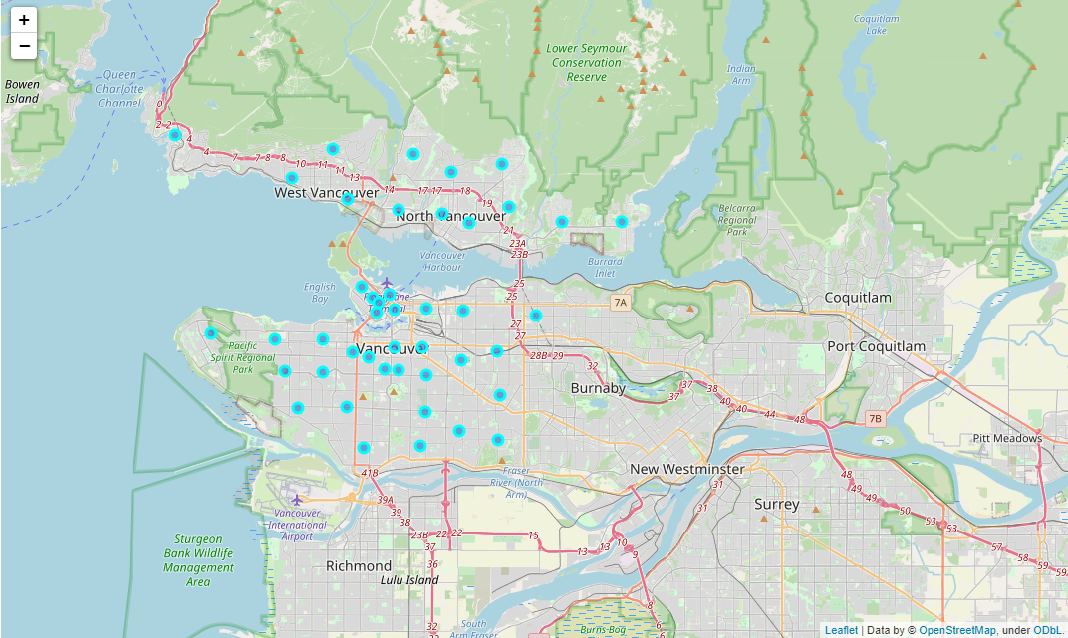
Vancouver Neighborhoods Map
Map1: Vancouver neighborhoods via Folium

Slide 6
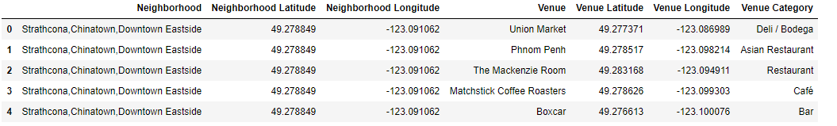
Methodology
Using Foursquare API, a radius of 2 km around the center of each neighborhood with a limit of 500 venues, and we were able to create a data frame that included what all neighborhood included what venue categories
248 unique venue categories were to be found via the Foursquare API and the above constraints. Some examples being; Café, Music Store, Trail, Science Museum, etc.
Table3: showing some of the venues and their category after using Foursquare API

Slide 7
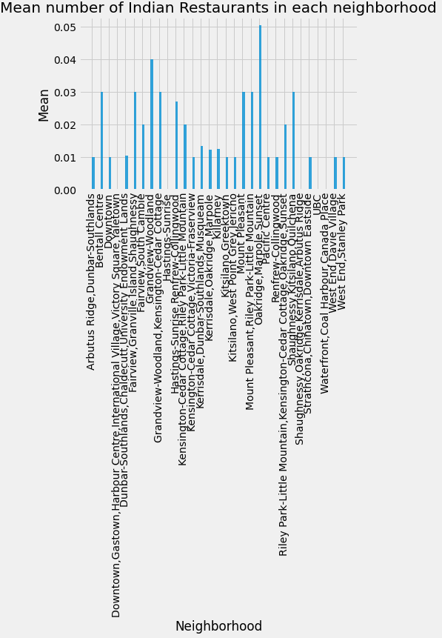
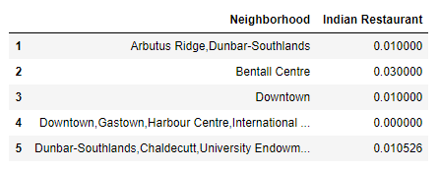
Methodology
Next using ‘Indian Restaurant’, a data frame was created to include all neighborhood which had an Indian restaurant. The value under ‘Indian restaurant’ is the mean of the frequency of occurrence of such category
Table4: mean of frequency of Indian restaurant in each neighborhood
Graph1: Mean number of Indian restaurants in each neighborhood

Slide 8
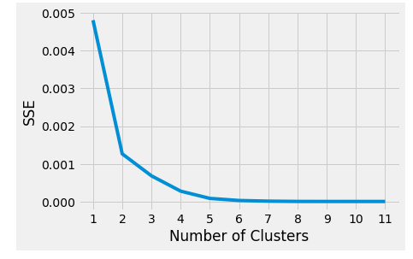
Methodology
We use K-means clustering to group the various neighborhoods for easier observation. But first, we use the elbow method to evaluate the optimal number of clusters that will be then used in K-means
Using the elbow method to find the optimal value of k
And confirming the value of k using KneeLocator.
K came out to be 3
Graph2: Number of clusters vs Error sum of squares

Slide 9
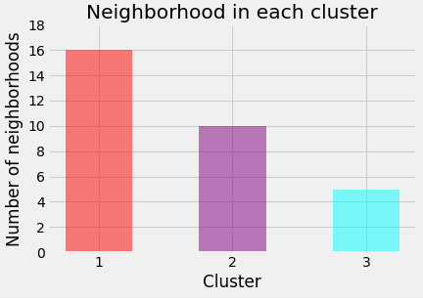
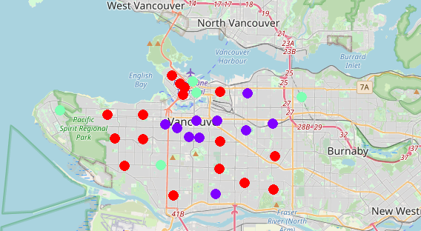
Methodology
With 3 clusters, K-means clustering was implemented and a folium map was created showcasing the 3 clusters
Cluster 1 is red
Cluster 2 is purple
Cluster 3 is cyan
Graph3: Number of neighborhoods in each cluster
Map2: Showing the 3 clusters via K-means

Slide 10
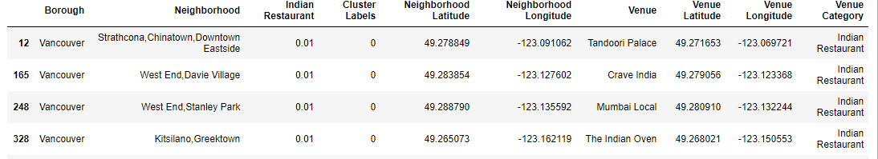
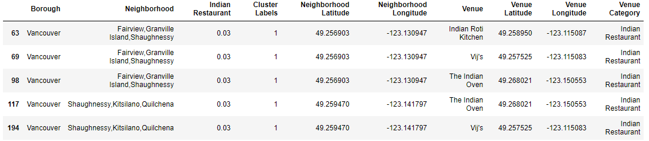
Methodology
A data frame was created with the 3 clusters but only including the venue category ‘Indian Restaurant’
Table 5: Cluster 1 where k = 0
Table6: Cluster 2 where k = 1
Table7: Cluster 3 where k = 2
Some duplicates were found in Venue and were cleaned accordingly to give out the unique number of Indian restaurants

Slide 11
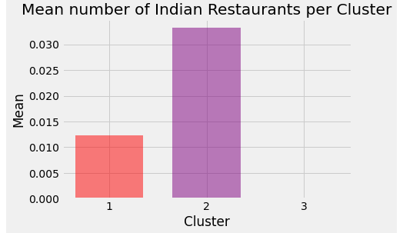
Results
First a data frame was created to analyze all the Postal Codes in British Columbia that included ‘Vancouver’ in the Borough
Unique number of Postal Codes came out to be 43
248 unique venue categories were to be found via the Foursquare API with a limit of 500 and a radius of 2 km
Mean number of Indian Restaurants in each neighborhood
Oakridge, Marpole Sunset had the highest mean number with Grandview-Woodland trailing
UBC, Waterfront, Coal Harbour, Canada Place etc. were some neighborhoods which had no Indian restaurants
Via K-means, 3 clusters were used and a map was created
Cluster1 has 16 neighborhoods
Cluster2 has 10 neighborhoods
Cluster3 has 5 neighborhoods
Number of unique venue categories
Cluster1 had 180 unique categories
Cluster2 had 152 unique categories
Cluster3 had 127 unique categories
Mean of the frequency of occurrence of Indian restaurant in each Cluster
Cluster1 had a mean of 0.0118
Cluster2 had a mean of 0.0329
Cluster3 had no Indian restaurants
Graph4: Mean number of Indian restaurants per Cluster

Slide 12
Discussions and Conclusion
Cluster 1 which occupies 16 different neighborhoods currently has 12 Indian restaurants
Cluster 2 which occupies 10 different neighborhoods currently has 16 Indian restaurants
Cluster3 which occupies 5 different neighborhoods has no Indian restaurants
After analyzing the Mean of the frequency of occurrence of Indian restaurant in each Cluster and the number of neighborhoods in each cluster
Cluster3 which occupies 5 different neighborhoods and has no Indian restaurants would be an ideal spot to start up an Indian restaurant!
In Cluster3, Coal Harbour, UBC, Canada Place neighborhoods and some others would be an optimal location to startup an Indian Restaurant!

Slide 13
The End! Thank you for reading through!

